Slide 1
Berserker
Presented by: 8-bit Bacon

Slide 2
Team members

Slide 3
The Vision
-Concept Vision goes here-

Slide 4
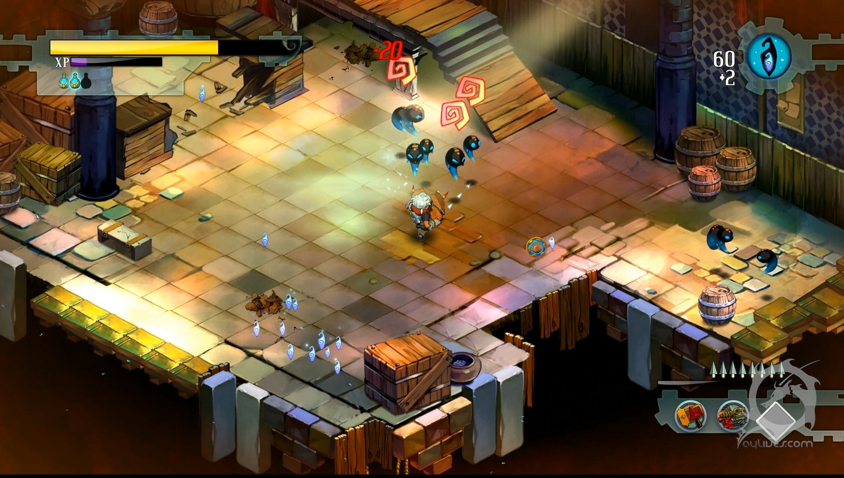
Inspiration

Slide 5
Player Actions
Attack
65%
Dash
25%
Grab
10%

Slide 6
Attack
X
Attack
Player attacks with their melee weapon.
-Art of player attacking enemies, manipulating environment, deflecting projectiles-

Slide 7
Dash
A
Dash
Player dashes in the direction they are facing.
-Art of player dashing and evading an exploding enemy and pushing enemies back

Slide 8
Grab
B
Grab
Player grabs an enemy or object in front of them.
-Art of player grabbing and tossing an enemy, flipping a lever-

Slide 9
Game Flow
Progress
Combat
Progress
Combat
Exit

Slide 10
Enemies
Melee Blob
If P is within range
Move to Player
Attack Player (1s)
10 M
1 M
-Art of 2 enemy types, melee and ranged blob-
Ranged Blob
If P is within range
Move to Player
Attack Player (1s)
30 M
10 M
If P closer than 9M

Slide 11
Enemies
Move to Player, activate bomb
Explosive Minion
If P is within range
Explode (2s)
10 M
1 M
-Art of 2 enemy types, Explosive Minion and Yeti-
Yeti
If P is within range
Move to Player
Attack Player (3s)
5M
2M

Slide 12
Enemies
Magma Beast
If P is within range
Move to Player
Attack Player (3s)
5 M
2M
-Art of Magma Beast-

Slide 13
The Hero
The Hero is a seasoned, tall, lean warrior who wields a one-handed sword.
-Art of Protagonist here-
Attributes
If Health = 0, restart at checkpoint, decrement lives
Health
If Lives = 0 Game Over

Slide 14
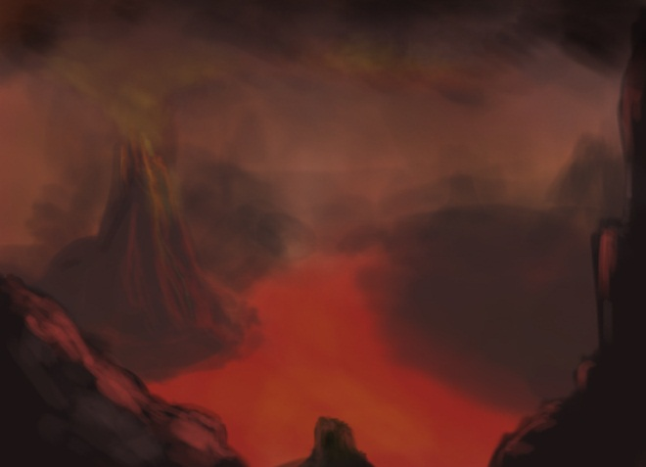
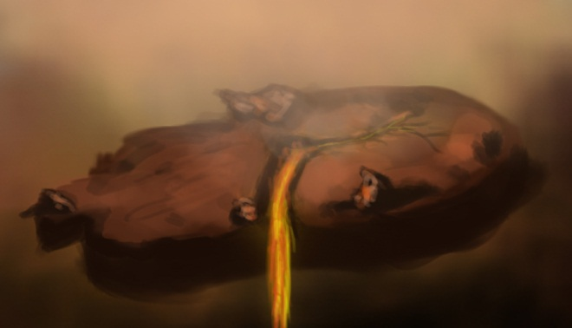
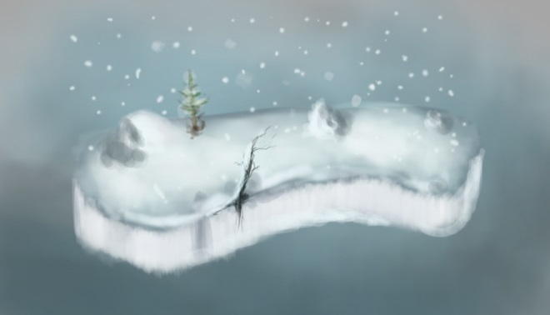
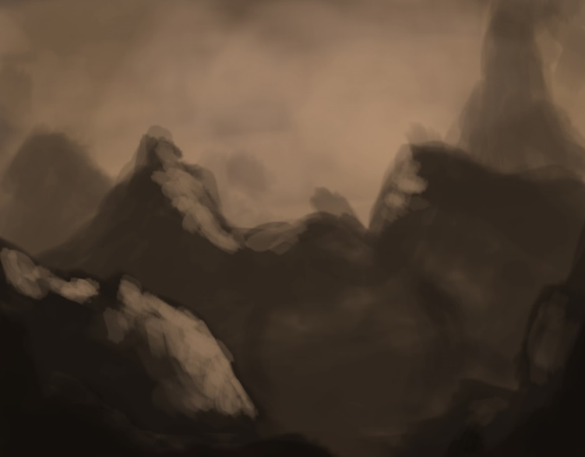
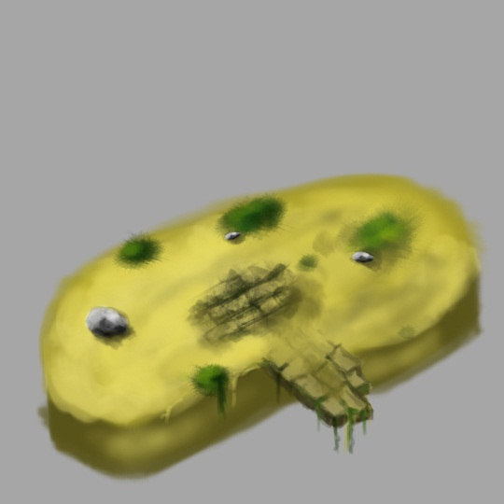
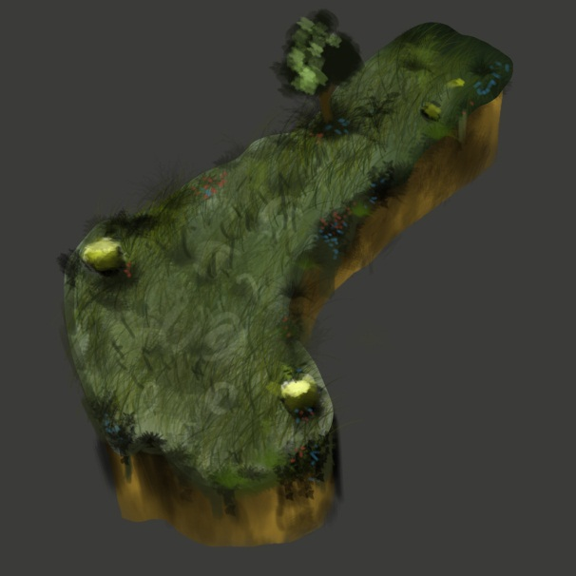
Where
Alternate fantasy realm

Slide 15
Where – Ice Realm
An icy tundra consisting of …

Slide 16
Where - Lava Realm
An evil realm, consisting of…

Slide 17
Where – Wizard’s Castle
The place where the player confronts the evil wizard.

Slide 18
Level Layout

Slide 19
Why
The player is on a quest to reclaim his lost love and defeat the evil wizard.

Slide 20
Wizard AI – Orb Attack
The wizard launches a fast-travelling orb at the player, which deals a small amount of damage if not deflected.
Tell: The wizard raises his staff over his head, then swings it downward at the player.
Orb Attack
Raise/ Lower Staff
Launch Orb
Small Damage
1.5s
0.5s

Slide 21
Wizard AI – Orb Concept

Slide 22
Wizard AI – Lava Plume
The wizard raises both arms above his head and creates a red space underneath the player, which erupts after a small period of time.
Tell: The wizard raises both arms over his head, and his hands glow red.
Lava Plume
Raises arms
Creates plume
Large Damage
1.0s
2.0s

Slide 23
Wizard AI – Lava Plume Concept

Slide 24
Wizard AI – Summon Minions
The wizard can call minions to his aid to assist him in the fight. This attack does no damage.
Tell: The wizard slams his staff to the ground, opening a gate that spawns minions.
Summon Minions
Slams staff
Opens gate
No Damage
0.5s
0.5s

Slide 25
Wizard AI – Summon Concept

Slide 26
Wizard Fight Stages
Boss state changes based on health. When the boss’ health hits zero, the boss is defeated.
Fight Starts
Orb Attack
Lava Plume
Summon (15s)
Boss Dies
66% HP
33% HP
Orb Attack
Lava Plume
Orb Attack

Slide 27
HUD

Slide 28

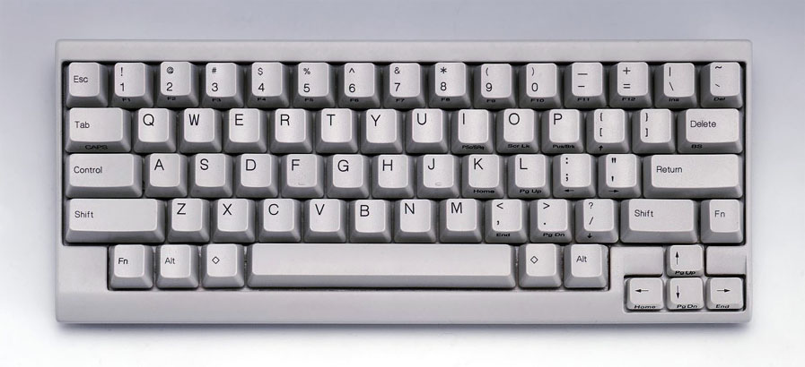
Controls - Keyboard
Move
Dash
Attack
Grab
Pause

Slide 29
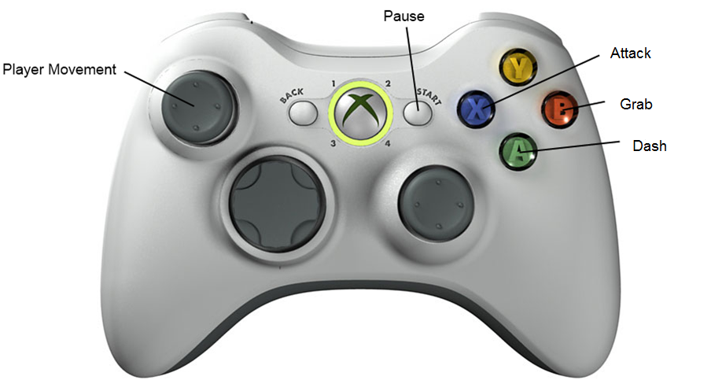
Controls - Controller

Slide 30
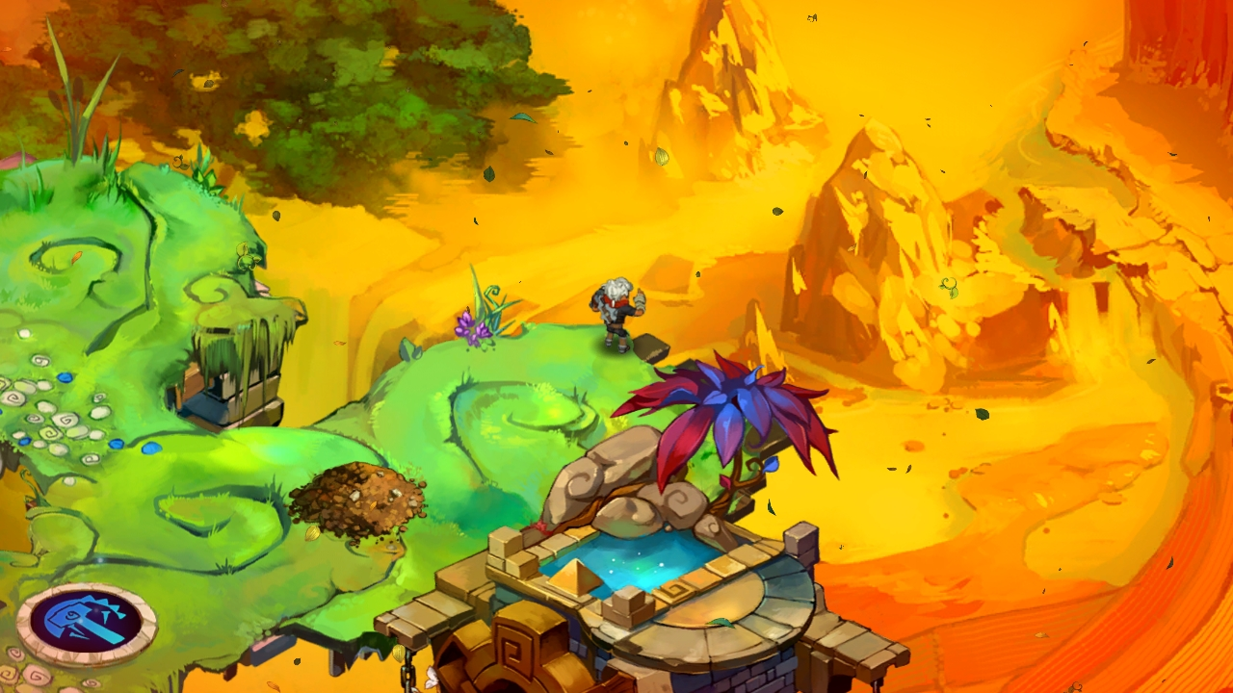
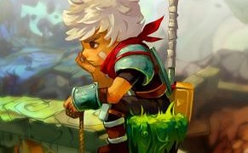
Art Style

Slide 31
Recap
Intense, fast-paced ¾ view Hack-and-Slash
Takes place in an alternate fantasy realm
You control a seasoned warrior who is on a quest to save his lost love.

Slide 32
Questions?

